Slide 1

Rice University FinTech Project One: Botley Fool (Automated Technical Analysis & Trading)
Group 1: Blake Gregory and Maurice Duré

Slide 2
Botley Fool
An Analysis of Technical Indicators Used for Trading - Analyzed Across Different Markets to Determine Which May or May Not Provide the Best Indication

Slide 3
Motivation

Slide 4
Trading Strategies:
Buy five shares in three companies across three markets - Healthcare, Oil & Gas, and Technology.
Utilize Alpaca to buy the different positions and create the portfolio.
Choose the most used indicators then run analysis.
Use the Alpha Vantage API to retrieve technical indicator performance for each position in our portfolio at an hourly interval.

Slide 5
Hypothesis and Goal
To find the most efficient indicator or group of indicators to implement into our botley fool.
We will test different trading strategies using data fetched with the Alpaca API and market indicators implemented using Alpha Vantage API
The goal is to pull trading data and results, analyze and then visualize results to show why the trading strategies we are using are the most efficient in the trading bot for the lowest risks with the highest returns based on the data.

Slide 6
Most Commonly Used Technical Indicators
OSCILLATORS- Construct high and low bands between two extreme values, and then builds a trend indicator that fluctuates within these bounds.
Traders use the trend indicator to discover short-term overbought or oversold conditions.
~When the value of the oscillator approaches the upper extreme value, analysts consider the asset to be overbought.
~When the value of the oscillator approaches the lower extreme value, analysts consider the asset to be oversold.

Slide 7

Indicators being Analyzed

Slide 8

Simple Moving Average

Slide 9
SMA
Calculates the mean of a given set of prices over the specific number of days in the past; i.e. over the previous 15/30/100/200 days.

Slide 10
Exponential Moving Average

Slide 11
EMA
Weighted average that gives greater importance to more recent stock price making it more responsive to new trends.

Slide 12

Moving Average Convergence Divergence

Slide 13
MACD indicator
Calculated by subtracting the 26-period EXPONENTIAL MOVING AVERAGE (EMA) from the 12-period EMA; the result of that calculation is the MACD. When MACD is positive, the short-term average is located above the long-term average; this is an indication of upward MOMENTUM.

Slide 14
MACD continued
When MACD is negative, the short-term average is located below the long-term average; this is an indication of downward MOMENTUM. * Many traders will also watch for a move above or below the zero line. A move above zero signals a buy, while a cross below zero signals to sell. * Based on the assumption that the tendency of the price of a traded asset is to revert to a trend line. To discover the trend line, look at the MOVING AVERAGE of asset prices over different time periods, i.e. 50/100/200 days.

Slide 15

Relative Strength Index

Slide 16
RSI
Compares the size of recent gains to recent losses to determine an asset's price MOMENTUM, either up or down.
The RSI was designed to indicate whether a security is overbought or oversold in relation to recent price levels.
The RSI is calculated using average price gains and losses over a given period of time.
The default time period is 14 periods with values bounded from 0 to 100.

Slide 17
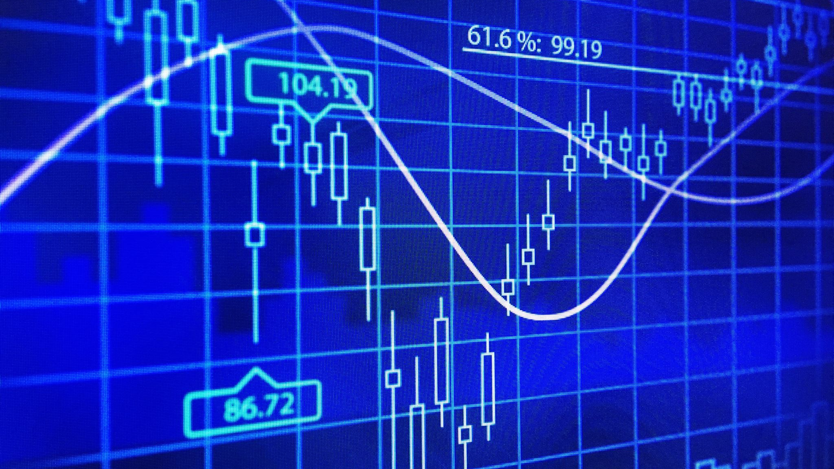
Bollinger Bands

Slide 18
Bollinger Bands
A technical indicator that has bands generally placed two STANDARD DEVIATIONS away from a SIMPLE MOVING AVERAGE.A move toward the upper band suggests the asset is being overbought and a move closer to the lower band suggests the asset is being oversold.
Since STANDARD DEVIATION is used as a statistical measure of VOLATILITY, this indicator adjusts itself to market conditions.

Slide 19

Top 3 Returns
Notes:
The top 3 indicators will be combined into the code and used

